Slide 1

Object Detection using Haar Cascade
By:- Apoorv Khare
Shubham Agarwal

Slide 2
Computer Vision
Computer vision is an interdisciplinary scientific field that deals with how computers can gain high-level understanding from digital images or videos. From the perspective of engineering, it seeks to understand and automate tasks that the human visual system can do.
Computer vision tasks include methods for acquiring, processing, analyzing and understanding digital images, and extraction of high-dimensional data from the real world in order to produce numerical or symbolic information, e.g. in the forms of decisions. Understanding in this context means the transformation of visual images (the input of the retina) into descriptions of the world that make sense to thought processes and can elicit appropriate action. This image understanding can be seen as the disentangling of symbolic information from image data using models constructed with the aid of geometry, physics, statistics, and learning theory.

Slide 3
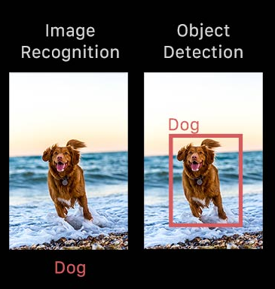
What is Object Detection?
Object detection is a computer vision technique that works to identify and locate objects within an image or video. Specifically, object detection draws bounding boxes around these detected objects, which allow us to locate where said objects are in (or how they move through) a given scene.
Object detection is commonly confused with image recognition, so before we proceed, it’s important that we clarify the distinctions between them.
Image recognition assigns a label to an image. A picture of a dog receives the label “dog”. A picture of two dogs, still receives the label “dog”. Object detection, on the other hand, draws a box around each dog and labels the box “dog”. The model predicts where each object is and what label should be applied. In that way, object detection provides more information about an image than recognition.

Slide 4
Why is object detection important?
Object detection is inextricably linked to other similar computer vision techniques like image recognition and image segmentation, in that it helps us understand and analyze scenes in images or video.
But there are important differences. Image recognition only outputs a class label for an identified object, and image segmentation creates a pixel-level understanding of a scene’s elements. What separates object detection from these other tasks is its unique ability to locate objects within an image or video. This then allows us to count and then track those objects.
Given these key distinctions and object detection’s unique capabilities, we can see how it can be applied in a number of ways:
Crowd counting
Self-driving cars
Video surveillance
Face detection
Anomaly detection

Slide 5
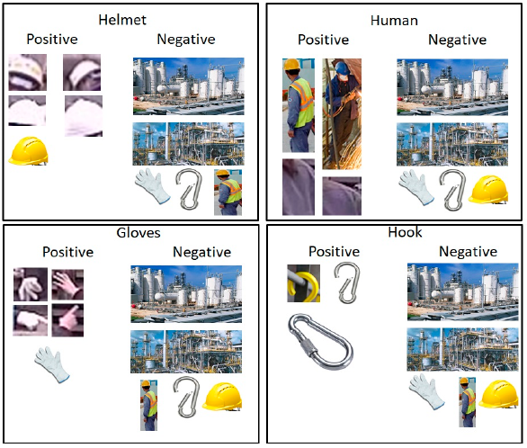
Haar Cascade
Haar Cascade classifiers are an effective way for object detection. This method was proposed by Paul Viola and Michael Jones in their paper Rapid Object Detection using a Boosted Cascade of Simple Features .Haar Cascade is a machine learning-based approach where a lot of positive and negative images are used to train the classifier.
Positive images – These images contain the images which we want our classifier to identify.
Negative Images – Images of everything else, which do not contain the object we want to detect.
During the detection phase, a window of the target size is moved over the input image, and for each subsection of the image and Haar features are calculated. This difference is then compared to a learned threshold that separates non-objects from objects. Because each Haar feature is only a "weak classifier" (its detection quality is slightly better than random guessing) a large number of Haar features are necessary to describe an object with sufficient accuracy and are therefore organized into cascade classifiers to form a strong classifier.

Slide 6
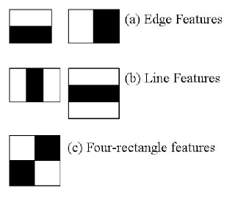
Algorithm working of HAAR CAscade
Here we will work with face detection. Initially, the algorithm needs a lot of positive images (images of faces) and negative images (images without faces) to train the classifier. Then we need to extract features from it. For this, haar features shown in below image are used. They are just like our convolutional kernel. Each feature is a single value obtained by subtracting sum of pixels under white rectangle from sum of pixels under black rectangle.
Now all possible sizes and locations of each kernel is used to calculate plenty of features. For each feature calculation, we need to find sum of pixels under white and black rectangles. To solve this, they introduced the integral images. It simplifies calculation of sum of pixels, how large may be the number of pixels, to an operation involving just four pixels.
Notes:
Adaboost:AdaBoost is an ensemble learning method (also known as “meta-learning”) which was initially created to increase the efficiency of binary classifiers. AdaBoost uses an iterative approach to learn from the mistakes of weak classifiers, and turn them into strong ones.

Slide 7
But among all these features we calculated, most of them are irrelevant. For example, consider the image below. Top row shows two good features.
The first feature selected seems to focus on the property that the region of the eyes is often darker than the region of the nose and cheeks.
The second feature selected relies on the property that the eyes are darker than the bridge of the nose. But the same windows applying on cheeks or any other place is irrelevant.
So how do we select the best features out of 160000+ features? It is achieved by Adaboost.
:AdaBoost is an ensemble learning method (also known as “meta-learning”) which was initially created to increase the efficiency of binary classifiers. AdaBoost uses an iterative approach to learn from the mistakes of weak classifiers, and turn them into strong ones.

Slide 8
Implementation

Slide 9
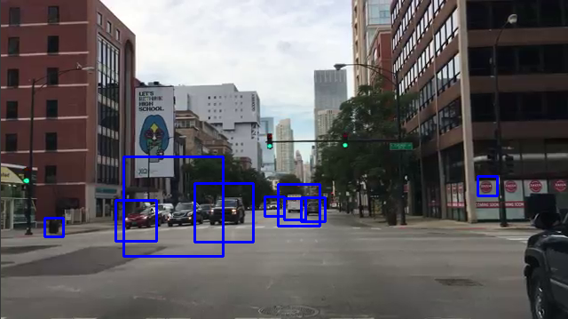
Results
Object detection of cars

Slide 10
Limitations of HAAR Cascade
Results are tricky to interpret in blur images
A better result (compared to an optimal single classifier) will not always be achieved.
One known issue is the computing time based on different classifier methods.

Slide 11
Software Requirement
3.1 Hardware Requirements:
Processor: Intel ® Core$(TM) i3 -6200U$CPU @2.30GHz 2.40GHz
Disk Space : 1 TB
Ram : 4 GB and above
3.2 Software Requirements:
Numpy
Opencv
Matplotlib

Slide 12
Thank you!!!!

